Slide 2
Contents
Introduction
Solution Overview
Solution Components
  Process Module: Collaborative Inventory Management
  Process Module: Collaborative PO Management
  Common Application Layer
  Technical Module: Connectivity
  Technical Module: Infrastructure
  Rapid Implementation Methodology
  Rapid Supplier Adoption Methodology
  Diagnostic Module: Benefits Calculation

Slide 3
Introduction Placeholder
Introduce PwC Retail POV
Introduce Problem – OOS
Introduce Heartbeat as solution

Slide 4
Contents
Introduction
Solution Overview
Solution Components
  Process Module: Collaborative Inventory Management
  Process Module: Collaborative PO Management
  Common Application Layer
  Technical Module: Connectivity
  Technical Module: Infrastructure
  Rapid Implementation Methodology
  Rapid Supplier Adoption Methodology
  Diagnostic Module: Benefits Calculation

Slide 5
Heartbeat is a solution focused on the velocity of product movement and is built on a solid foundation necessary to achieve success
Building Blocks of Collaboration NEED ANOTHER WORD!
Data Analysis
Provides visibility into product movement velocity to predict out-of-stock condition
Enables focused store-level response to problem conditions
Provides insight into inventory movement to refine forecasting and inventory models
Standards
Provides database coding, communications protocols and interface templates to allow solution partners to read data and execute processes consistently
Reduces implementation time
Increases accessibility of POS transactional data
Enables stores, corporate, manufacturer and direct to store suppliers to work effectively together across company boundaries
Allows partners to understand information, make decisions and respond quickly to opportunities and challenges
Collaborative Processes
Organizational
Change
Provides adoption of methods to facilitate intra- and inter-enterprise change
Enhances collaborative relationships between participants internally and externally
Provides the ability to work together to exploit opportunities and mitigate risks

Slide 6
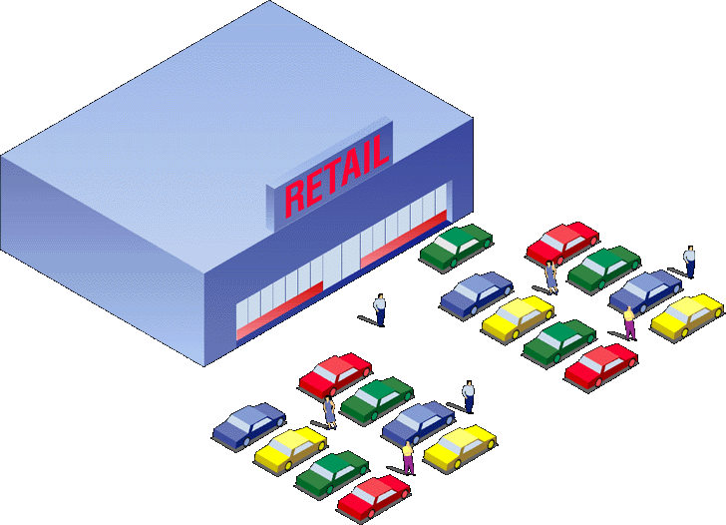

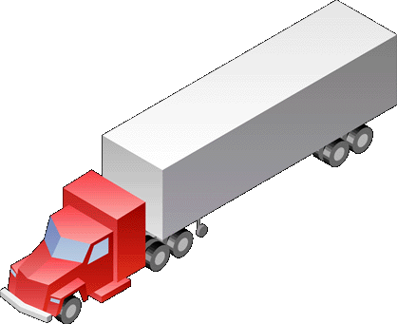


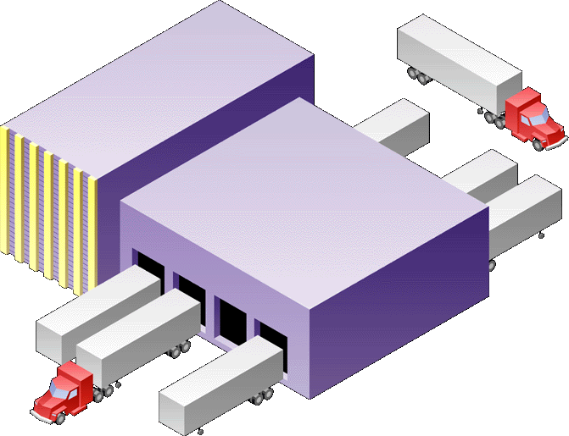

The Rapid SCC Hub functionality lays the foundation for rapid time to benefit that can be realized across the entire collaborative network
Rapid SCC Hub
A collaborative solution for direct materials
Establishes a Many-to-Many collaborative infrastructure by connecting supply chain partners and BU’s through both B2B connectivity and portal access
Utilizes a technical architecture that extends, not replaces, existing IT infrastructure
Provides a rapid path to achieving cost reductions
Tailoring the solution and selection of application vendors appropriate to customer needs to provide the ability to:
  View Inventory Levels across a multi-level supply-chain
  Manage Purchase Order (PO) – transact, monitor, negotiate exceptions
  Manage issues with alerts and notifications
Leverage the ongoing experience and learnings of HP’s internal implementation (KeyChain) and use of the solution
8 Modules
Internal
External
BU
CM
BU
Tier 1
Suppliers
eHub
BU
Tier 2
Suppliers
BU
LSP
The Rapid SCC Hub is a holistic approach to collaboration that encompasses technology, process, strategy, and the change management that are critical to realizing a quick time-to-benefit

Slide 7


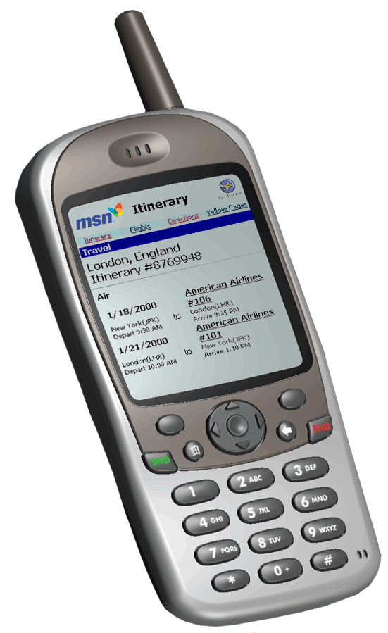


the Microsoft-Intel
Retail Supply Chain Initiative
Suppliers
BizTalk Server
A
P
P
L
I
C
A
T
I
O
N
S
Repl
Plan
E
N
T
E
R
P
R
I
S
E
Alloc
A
D
A
P
T
E
R
S
CRM
P
O
S
Transform
Orchestrate
Route
SA
Merch
LP
Fin
Rpt
DSS
Services
Notification
Devices

Slide 8
OUT OF STOCKS
BUSINESS VALUE
Results from Pilots:
Out of Stocks Reduced by 25%+.
1-2% Per-Door Revenue Increase.
Increase revenues 5-6%
On Top 200 items.
Accurate Prediction of
Key SKU OOS’s
On a per-door basis
Via real-time POS data
Real-time, time-effective
Per-store notification
Also: web-based links
back to vendor supply chain
For replenishment
At the core:
Web-connected Point of Sale . . .
Real-time Predictive OOS Analysis per door
Notification to in-store desktop, PDA’s
POS
WEB
SVCS
D.V.
WEB
SVCS
STORE
DATA VENTURES, SYSTECH
Software
MICROSOFT W2K
Op System
COMPAQ
Hardware
BLACKBERRY PAGERS, COMPAQ
Wireless
MICROSOFT .NET
Web Svcs

Slide 9
The zxc is leveraging the on-going lessons learned from the pilot implementations
Reduce out-of-stocks by 25%
Average revenue increase of 1 - 2%
Average revenue increase of top 200 items of 5 – 6%
Increase sales per square foot
Improve margins
Improve sales forecasting
Decrease inventory levels

Slide 10
The Rapid SCC Hub implementation process creates value for each member of the supply chain providing a “Win-Win” for all
Manufacturer
Retailer
Consumer
Improved Visibility to Inventory
  Higher inventory turns
  Inventory savings
  Reduced direct materials costs
Improved PO Management
  Reduced transaction costs
  Reduced errors
Improved visibility to OEM demand and inventory of suppliers
  Inventory reduction
  Greater flexibility
  Better planning and forecasting
Lower cost of doing business with OEM
Visibility to OEM’s/CMs forecasts, POs and, replenishment requirements
  Inventory reduction
  Takes cost / overhead out of suppliers’ systems, gives them flexibility
Improved allocation of scarce materials
Better capacity planning/ improved ROI
  Reduced transportation and warehousing costs

Slide 11
Heartbeat – What is it?
Real-time item velocity monitor
Predicts out-of-stock conditions
Stock position monitor to prevent OOS
Alert messenger

Slide 12
Solution Partners
Data Ventures
  Statistical and predictive analysis engine
Intel
  Architecture scalability quality assurance
Microsoft
  Microsoft.net Services
    BizTalk Server
    SQL Server
    Message Que Server
    Visual Studio 6.0
  Microsoft Consulting
    Technology services
PwC Consulting
  Heartbeat Fitness Tool?
  Change management
  Project management
Systech
  POS data interface mapping and programming support

Slide 14
The Rapid SCC Hub solution includes a comprehensive Rapid Implementation methodology
Rapid Implementation Methodology
(collaborative network build)
Envision
Design
Construct
Test
Pilot & Launch
Support & New Functionality

Slide 15
Rapid Implementation Methodology
eHub Build
Methodology
Rapid Implementation Methodology
(collaborative network build)
ENVISION
DESIGN
CONSTRUCT
TEST
PILOT & LAUNCH
SUPPORT & NEW FUNCTIONALITY
FORMULATE
DESIGN
BUILD
TEST
LAUNCH
SUPPORT & MAINTAIN
Scope
Requirements Gathering & Definition
eHub Configuration & Mapping
Benchmarking
Infrastructure Testing
Set-up & Testing
Migration Strategy
eHub Architecture
eHub Integration
Commitment Plan
Change Requests & Adaptation
Transition to On-Boarding
Documentation
Knowledge Management
Training
Knowledge Transfer
Project Plan
Scenario Development
Release Management
Infrastructure Definition & Installation/Set-up
Project Management
7 months
7 months

Slide 16
Envision…
eHub Build
Methodology
ENVISION
Scope
  Identify items to be tracked by “Heartbeat”
  Scope validation
Documentation
  Define collaboration hub architecture
  Document impact of new/modified features
  Document integration points & process flows
  Document testing and training strategy
Project Plan
  Identify project resources
  Budget FTEs
  Estimate timeline
ENVISION
FORMULATE
Scope
Documentation
Project Plan

Slide 17
Design…
eHub Build
Methodology
DESIGN
Requirements Gathering & Definition
  Technical requirements definition/gathering & documentation
  Functional requirements definition/gathering & documentation
Design Rapid SCC Hub Architecture
Design Rapid SCC Hub Integration Points
Scenario Development
  Design testing scenarios
  Validate scenarios
Infrastructure Definition:
  Hardware
  OS
  Databases & apps
Project Management (on-going)
  SCC Hub deployment plan
DESIGN
DESIGN
Requirements Gathering & Definition
eHub Architecture
eHub Integration
Scenario Development
Infrastructure Definition & Installation/Set-up
Project Management

Slide 18
Construct…
eHub Build
Methodology
CONSTRUCT
SCC Hub Configuration & Mapping
  Configure hub based on defined requirements
  Map data and build connectivity between eHub and external solutions
Commitment Plan
  Obtain broad organizational plan acceptance
Knowledge Management
  Knowledge transfer plans & processes
  Knowledge transfer measurements
Infrastructure Definition, Installation/Set-up
  Install hardware
  Install OS
  Install databases & apps
  Set-up infrastructure
Project Management (on-going)
CONSTRUCT
BUILD
eHub Configuration, Mapping
Commitment Plan
Knowledge Management
Infrastructure Definition & Installation/Set-up
Project Management

Slide 19
Test…
eHub Build
Methodology
TEST
Rapid SCC Hub Benchmarking
Infrastructure Testing
  Acceptance Testing
  Plan for disaster recovery
  Prepare for launch
Training
  Prepare training documents
  Train client
Infrastructure Definition & Installation/Set-up
  System testing
  Integration Testing
Project Management (on-going)
TEST
TEST
Benchmarking
Infrastructure Testing
Training
Infrastructure Definition & Installation/Set-up
Project Management

Slide 20
Pilot & Launch…
eHub Build
Methodology
PILOT & LAUNCH
Set-up and Testing
  Set-up initial partners
  Test initial partners
  Go live/no go issues resolution
Change Requests & Adaptation
  Launch solution
  Document change requests
  Recommend change requests
Knowledge Transfer
  Train client on Rapid SCC Hub Solution
Project Management (on-going)
PILOT & LAUNCH
LAUNCH
Set-up & Testing
Change Requests & Adaptation
Knowledge Transfer
Project Management

Slide 21
Support & New Functionality…
eHub Build
Methodology
SUPPORT & NEW FUNCTIONALITY
Migration Strategy
  Migrate existing partners to the Rapid SCC Hub
  Provide on going system support
Transition to On-boarding
  Initiate Rapid SCC Hub marketing
  Knowledge transfer & support of the hub
Release Management
  Identify next business functionality release
  Consider supply chain partner readiness and need for new functionality
Project Management (on-going)
  Build work stream closure
SUPPORT & NEW FUNCTIONALITY
SUPPORT & MAINTAIN
Migration Strategy
Transition to On-Boarding
Release Management
Project Management

